Slide 1
SPOKEN LANGUAGE PROCESSING · SUMMER 2026
Audio Deepfake Detection Using Traditional Speech Features and Machine Learning
Waad Ziadeh · Warda Bairat · Rand Saleh
Department of Electrical and Computer Engineering, Birzeit University

Slide 2
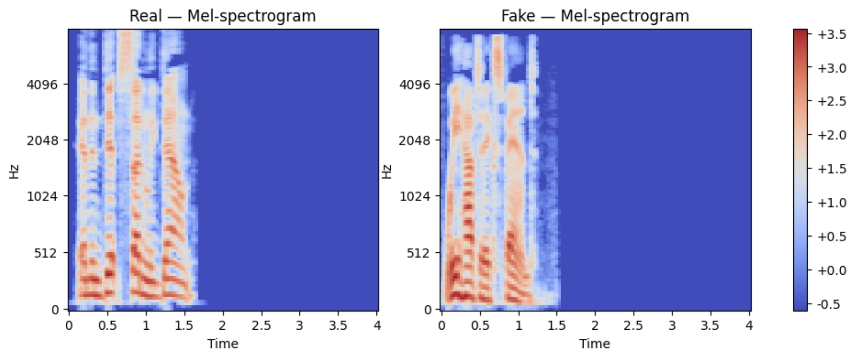
MOTIVATION
Synthetic speech is now hard to detect
Modern speech synthesis can sound convincingly real enough to impersonate real people — detection looks for the traces it still leaves behind.
Real vs. AI-generated speech — a genuinely similar acoustic signature

Slide 3
DATASET
One balanced dataset, one fixed split
ASVspoof 2021 Speech Deepfake (DF), Part00 — balanced to 11,070 clips: all 5,535 bonafide samples plus 5,535 randomly sampled spoof samples (seed 42).
Split | Bonafide | Spoof | Total
Training | 3,874 | 3,875 | 7,749
Validation | 830 | 830 | 1,660
Testing | 831 | 830 | 1,661
Total | 5,535 | 5,535 | 11,070
Same splits used across all three branches — identical clips in train/val/test for every method.

Slide 4
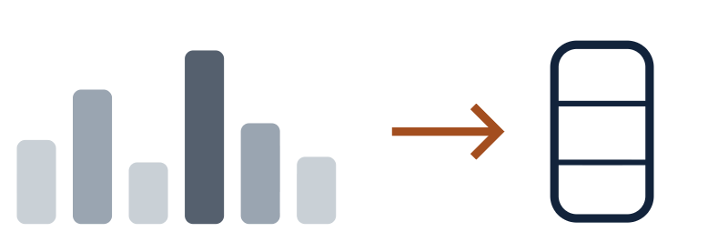

METHODOLOGY
Three feature representations, evaluated the same way
MFCC
LFCC
SPECTROGRAM
20 MFCCs, mean + std pooled
13 LFCCs, mean + std pooled
128-mel log-spectrogram
→ 40-dim vector
→ 26-dim vector
→ 128×126 matrix
RBF-SVM
RBF-SVM
3-block CNN
Identical train / validation / test split across all three branches

Slide 5
BRANCH 1 — WAAD ZIADEH
MFCC + RBF-SVM
20 MFCCs, mean + std pooled → 40-dim feature vector per clip
94.64%
94.62%
Accuracy
F1-score
RBF vs. linear kernel, tuned over C × γ (16 combinations)
98.90%
5.30%
Best: RBF-SVM, C=10, γ=0.1 — selected on validation F1
ROC-AUC
EER

Slide 6
BRANCH 2 — WARDA BAIRAT
LFCC + RBF-SVM
13 LFCCs, mean + std pooled → 26-dim feature vector per clip
86.57%
86.48%
Accuracy
F1-score
Same RBF vs. linear kernel search as the MFCC branch
93.93%
13.36%
Best: RBF-SVM, C=10, γ=0.1 — selected on validation F1
ROC-AUC
EER

Slide 7
BRANCH 3 — RAND SALEH
Spectrogram + CNN
128-mel log-spectrogram, 4s fixed length → 128×126 matrix
84.53%
85.31%
Accuracy
F1-score
3-block CNN (16 / 32 / 64 filters), 28,034 parameters
92.50%
17.00%
Lowest-val-loss checkpoint kept, not the final epoch's weights
ROC-AUC
EER

Slide 8
COMPARATIVE RESULTS
Comparing all three
Feature | Classifier | Accuracy | Precision | Recall | F1 | ROC-AUC | EER
MFCC | RBF-SVM | 94.64% | 94.91% | 94.34% | 94.62% | 98.90% | 5.30%
LFCC | RBF-SVM | 86.57% | 87.06% | 85.90% | 86.48% | 93.93% | 13.36%
Spectrogram | CNN | 84.53% | 81.18% | 89.88% | 85.31% | 92.50% | 17.00%
MFCC-SVM leads on every metric. The CNN has the highest recall of the three, but the lowest precision and accuracy.

Slide 9
LIMITATIONS
What the numbers don't cover
ASVspoof2021 DF is released in multiple parts — we used Part00 only, so results are not directly comparable to published full-dataset benchmarks
No cross-dataset test on synthesis methods the models never saw during training
MFCC/LFCC pooling keeps the coefficients' statistics but discards their timing
The CNN varied 89.95% → 84.53% test accuracy across two identical runs — one run alone doesn't characterize it

Slide 10
CONCLUSION
Traditional features still hold their own against a from-scratch CNN
Across MFCC, LFCC, and spectrogram-based detection, a carefully tuned RBF-SVM on compact cepstral statistics outperformed a compact CNN trained directly on spectrograms — though the CNN's 89.88% recall shows raw time-frequency features still catch real signal, with far less tuning behind them.
Questions?

